Slide 1



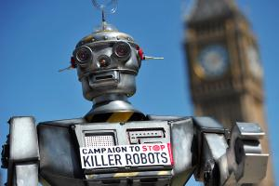
Killer Robots? UN treaty imminent…
UC Berkeley EECS Teaching Professor Dan Garcia
The Beauty and Joy of Computing Lecture #22
Limits of Computing
“The United Nations' Convention on Certain Conventional Weapons this week heard from technical and legal experts on the subject of killer robots, or ‘lethal autonomous weapons systems.’ There’s a growing consensus that it’s unacceptable for robots to kill without human control.”
www.newscientist.com/article/dn27339-can-we-stop-killer-robots-un-meets-to-debate-possible-treaty.html

Slide 2

Computer Science … A UCB view
www.eecs.berkeley.edu/Research/Areas/
CS research areas:
Artificial Intelligence
Biosystems & Computational Biology
Database Management Systems
Graphics
Human-Computer Interaction
Networking
Programming Systems
Scientific Computing
Security
Systems
Theory
Complexity theory
…

Slide 3
Let’s revisit algorithm complexity
www.csprinciples.org/docs/APCSPrinciplesBigIdeas20110204.pdf
Problems that…
are tractable with efficient solutions in reasonable time
are intractable
are solvable approximately, not optimally
have no known efficient solution
are not solvable

Slide 4
Tractable with efficient sols in reas time
Recall our algorithm complexity lecture, we’ve got several common orders of growth
Constant
Logarithmic
Linear
Quadratic
Cubic
Exponential
Order of growth is polynomial in the size of the problem
E.g.,
Searching for an item in a collection
Sorting a collection
Finding if two numbers in a collection are same
These problems are called being “in P” (for polynomial)

Slide 5
Intractable problems
en.wikipedia.org/wiki/Intractability_(complexity)#Intractability
Problems that can be solved, but not solved fast enough
This includes exponential problems
E.g., f(n) = 2^{n}
as in the image to the right
This also includes poly-time algorithm with a huge exponent
E.g, f(n) = n¹⁰
Only solve for small n
Imagine a program that calculated something important at each of the bottom circles. This tree has height n,
but there are 2^{n} bottom circles!
☑

Slide 6
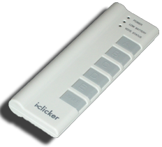
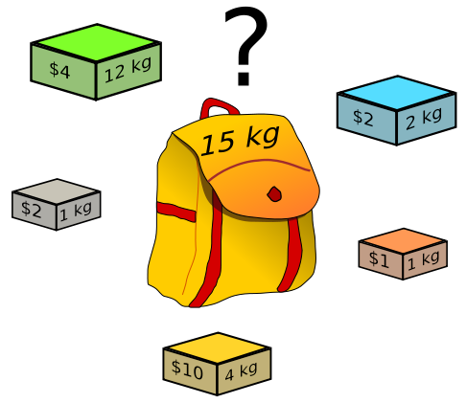
(Cal) Peer Instruction
What’s the most you can put in your knapsack?
$10
$15
$33
$36
$40
Knapsack Problem You have a backpack with a weight limit (here 15kg), which boxes (with weights and values) should be taken to maximize value? (any # of each box is available)

Slide 7
Solvable approximately, not optimally in reas time
en.wikipedia.org/wiki/Knapsack_problem
A problem might have an optimal solution that cannot be solved in reasonable time
E.g., optimization problems such as “find the best/smallest”
BUT if you don’t need to know the perfect solution, there might exist “approximation” algorithms which could give pretty good answers in reasonable time
Heuristic: a technique that may allow us to find an approximate solution (e.g., valuable stuff first!)
Some problems cannot be solved using any algorithm. (e.g., finding a robot path to a blocked-off area)
Knapsack Problem You have a backpack with a weight limit (here 15kg), which boxes (with weights and values) should be taken to maximize value?

Slide 8
Heuristics
A heuristic is a technique that may allow us to find an approximate solution when typical methods fail to find an exact solution.
Heuristics may be helpful for finding an approximate solution more quickly when exact methods are too slow.
Some optimization problems such as “find the best” or “find the smallest” cannot be solved in a reasonable time but approximations to the optimal solution can.
Some problems cannot be solved using any algorithm.

Slide 9
Have no known efficient solution
en.wikipedia.org/wiki/P_%3D_NP_problem
-2
-3
15
Solving one of them would solve an entire class of them!
We can transform one to another, i.e., reduce
A problem P is “hard” for a class C if every element of C can be “reduced” to P
If you’re “in NP” and “NP-hard”, then you’re “NP-complete”
If you guess an answer, can I verify it in polynomial time?
Called being “in NP”
Non-deterministic (the “guess” part) Polynomial
14
7
-10
Subset Sum Problem Are there a handful of these numbers (at least 1) that add together to get 0?

Slide 10
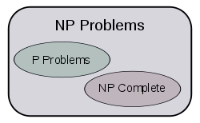
The fundamental question. Is P = NP?
en.wikipedia.org/wiki/P_%3D_NP_problem
This is THE major unsolved problem in Computer Science!
One of 7 “millennium prizes” w/a $1M reward
All it would take is solving ONE problem in the NP-complete set in polynomial time!!
Huge ramifications for cryptography, others
If P ≠NP, then
Other NP-Complete
Traveling salesman who needs most efficient route to visit all cities and return home

Slide 11
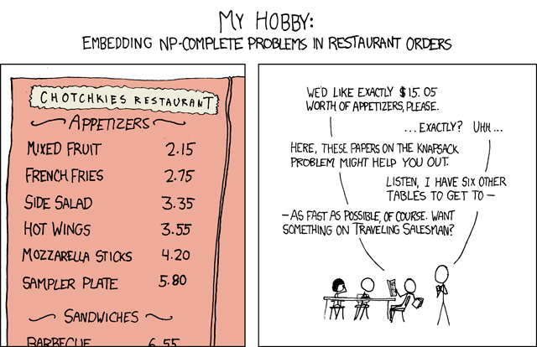
imgs.xkcd.com/comics/np_complete.png

Slide 12
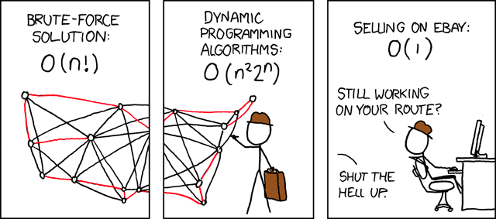
imgs.xkcd.com/comics/travelling_salesman_problem.png

Slide 13
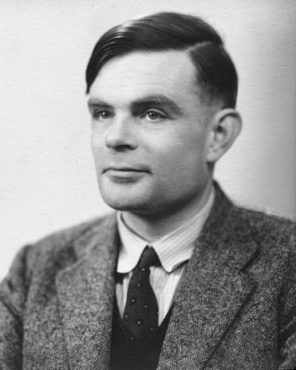
Problems NOT solvable
www.cgl.uwaterloo.ca/~csk/halt/
Decision problems answer YES or NO for an infinite # of inputs
E.g., is N prime?
E.g., is sentence S grammatically correct?
An algorithm is a solution if it correctly answers YES/NO in a finite amount of time
A problem is decidable if it has a solution
June 23, 2012 was his 100th birthday celebration!!
Alan Turing He asked: “Are all problems decidable?”
(people used to believe this was true)
Turing proved it wasn’t for CS!

Slide 14
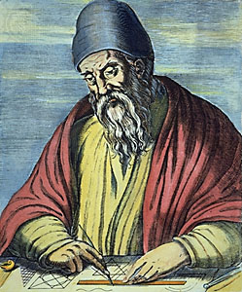
Review: Proof by Contradiction
Infinitely Many Primes?
Assume the contrary, then prove that it’s impossible
Only a finite set of primes, numbered p₁, p₂, …, p_{n}
Consider q=(p₁ • p₂ • … • p_{n})+1
Dividing q by p_{i} has remainder 1
q either prime or composite
If prime, q is not in the set
If composite, since no p_{i} divides q, there must be another p that does that is not in the set.
So there’s infinitely many primes
Euclid www.hisschemoller.com/wp-content/uploads/2011/01/euclides.jpg

Slide 15
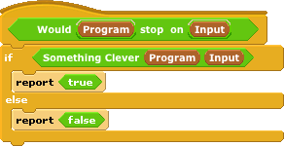

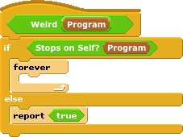

Turing’s proof : The Halting Problem
Given a program and some input, will that program eventually stop? (or will it loop)
Assume we could write it, then let’s prove a contradiction
1. write Stops on Self?
2. Write Weird
3. Call Weird on itself

Slide 16
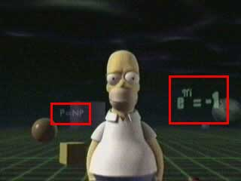
Conclusion
Complexity theory important part of CS
If given a hard problem, rather than try to solve it yourself, see if others have tried similar problems
If you don’t need an exact solution, many approximation algorithms help
Some not solvable!
P=NP question even made its way into popular culture, here shown in the Simpsons 3D episode!

Slide 18
(Cal) Admin Notes
Schedule (see website)

Slide 19
Data and Information

Slide 20

It’s a collaborative process!
Collaboration, in working with data to gain insight and knowledge:
…is an important part!
…applies multiple perspectives, experiences, and skill sets.
…involves communication between participants.
…includes developing hypotheses and questions, and in testing hypotheses and answering questions.
…can benefit from face-to-face and using online collaborative tools
…when Investigating large data sets can lead to insight and knowledge not obtained when working alone.
☑

Slide 21
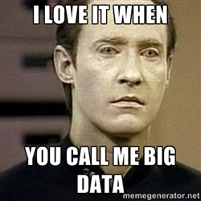
(Cal) Clicker Question
What do you think is the biggest data overall?
Text
Images
DNA
Videos
Census Data
Notes:
Data and information is hard to define. There are philosophical and meta-physical issues. So let’s all watch the Matrix…

